Slide 1
分子标记遗传连锁图和基因定位

Slide 2
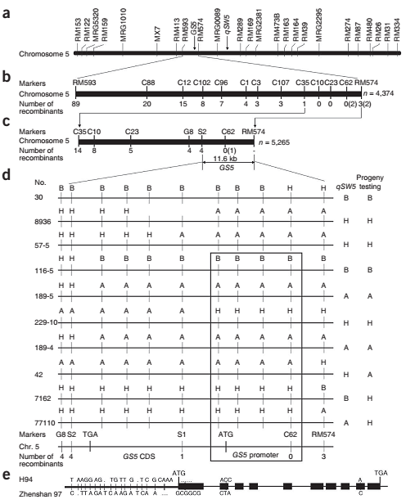
QTL mapping
map-based cloning of GS5
Li et al., 2010

Slide 3
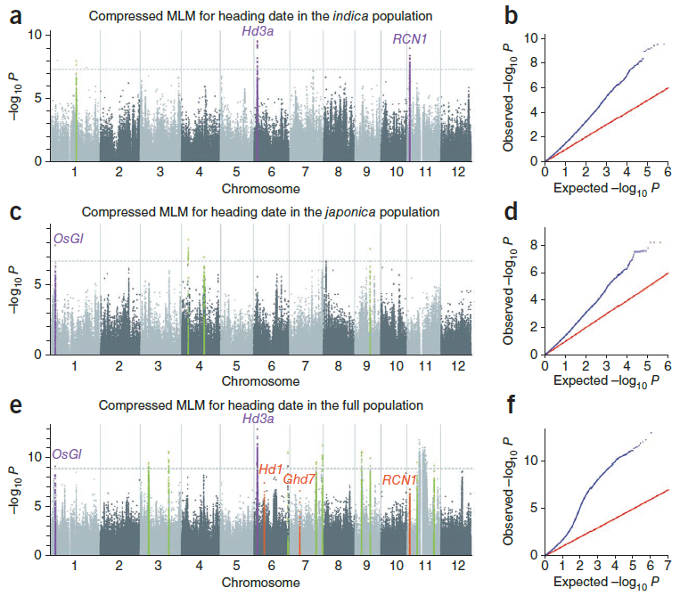
GWAS

Slide 4
OUTLINE
里程碑事件
遗传作图理论
遗传图谱案例
基因的定位

Slide 5
里程碑
遗传分离定律和自由组合定律
遗传连锁定律
第一张遗传图谱
第一张分子标记遗传图谱

Slide 6
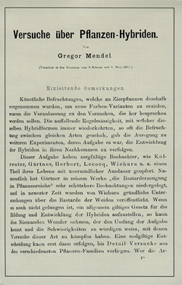
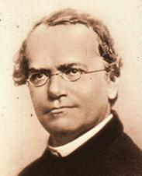
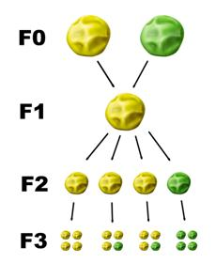
遗传分离定律和自由组合定律
Mendel

Slide 7
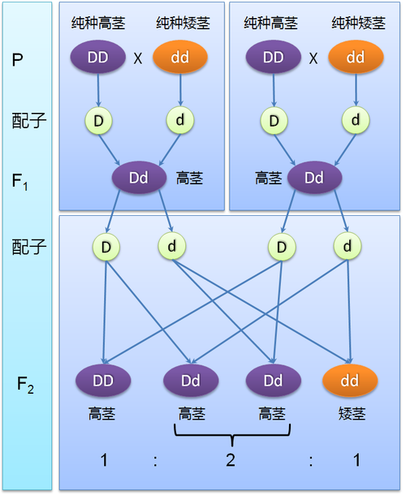
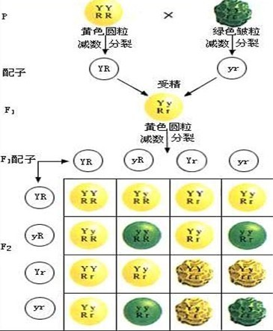
遗传分离定律
自由组合定律

Slide 8
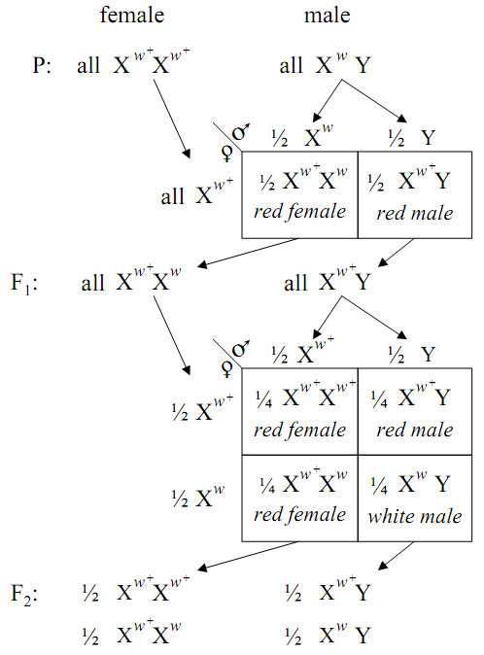
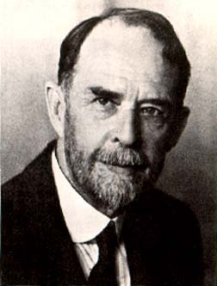
遗传连锁定律
决定眼色的基因与决定性别的基因是遗传连锁的
Morgan, T. H., Science, 1910

Slide 9
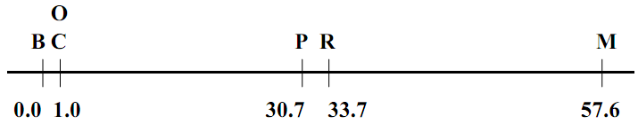
第一张遗传图谱
B stands for the black factor
C is a factor which allows color to appear in the eyes
O. Flies recessive with respect to O (o) have eosin eyes
P. Flies with p have vermilion eyes instead of the ordinary red
R. and M. both affect the wings
map distance ≠ physical distance
analyzed the effects of multiple cross-overs on the measurement of map distances
the occurrence of one cross over seems to inhibit the occurrence of additional cross overs
Sturtevant, A. H., Journal of Experimental Zoology, 1913

Slide 10
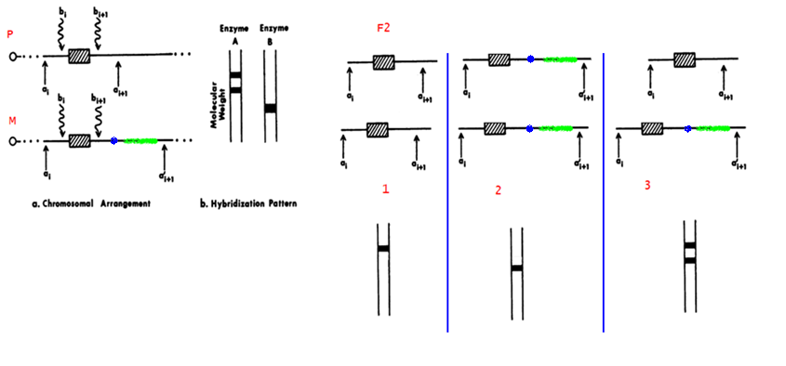
第一张分子标记遗传图谱
Botstein等第一次提出了RFLP可以作为遗传标记的思想，构建了第一张RFLP遗传连锁图
克服了形态标记和生化标记数量少的缺点，提高了基因定位的精度和速度
RFLP标记到底是什么？
Botstein, D., R. L. White, et al, American journal of human genetics, 1980

Slide 11
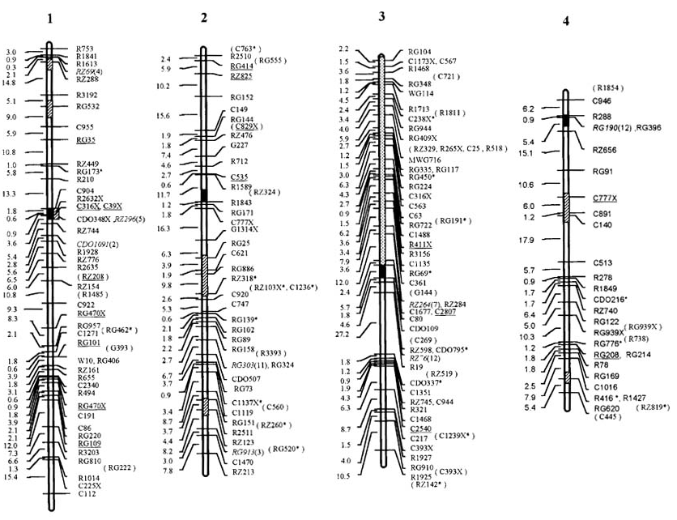
A high density RFLP map based on the F2 population of a cross between Oryza sativa and O. rufipogon using Cornell and RGP markers

Slide 12
遗传作图理论
图谱构建的理论基础
作图群体的建立
亲本选配
分离群体构建
设计分子标记并获取基因型数据
重组率的计算
图谱的构建

Slide 13
图谱构建的理论基础
染色体遗传理论
1903, W.S. Sutton, T. Boveri, 遗传因子位于染色体上
基因重组和连锁
重组率取决于交换频率
交换频率取决于直线距离

Slide 14
作图群体的建立 亲本选配
亲本间多态性
尽量选纯度高的材料，进一步通过自交进行纯化
杂交后代育性

Slide 15
作图群体的建立 分离群体构建
暂时性分离群体
F₂(容易建立，存在杂合基因型)
BC(作图效率高)
永久分离群体
RIL(耗时，反复使用)
DH(作图效率高，反复使用，花培)

Slide 16
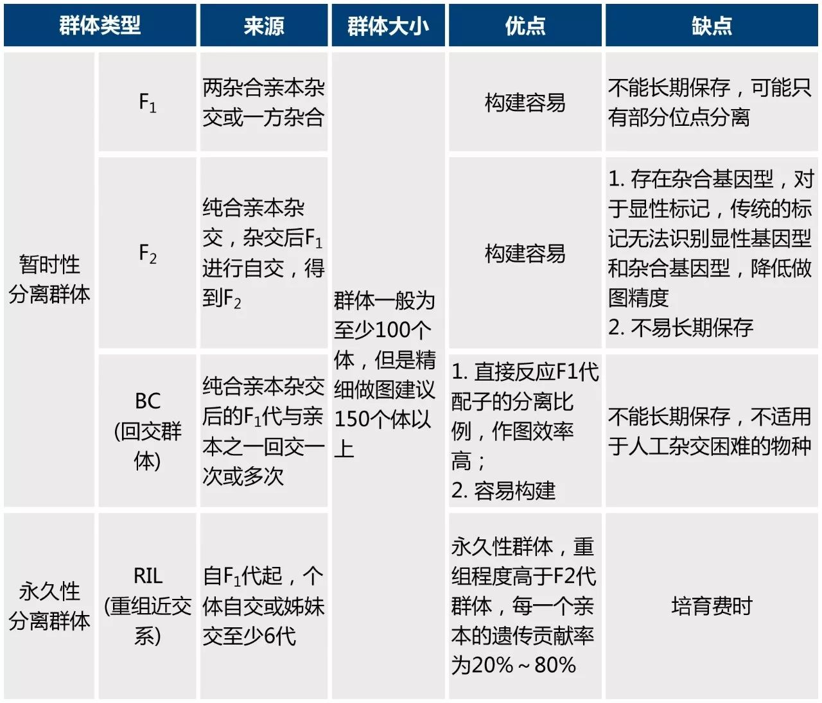

Slide 17
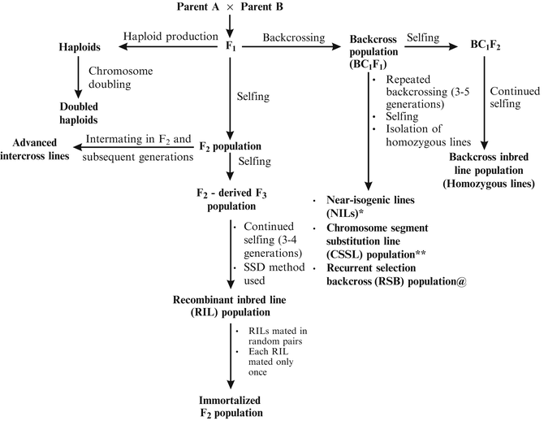
遗传作图群体

Slide 18
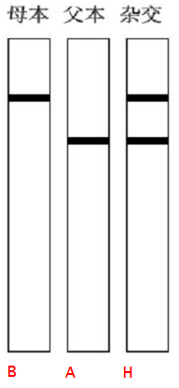
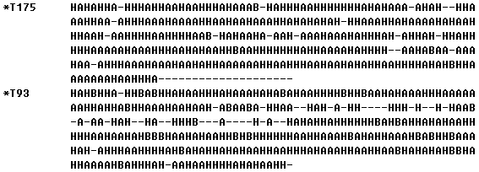
设计分子标记并获取基因型数据
P1
×
P2
F1
×
F2
考察F₂的基因型
2个标记，333个F₂

Slide 19
计算重组率
分离群体中重组型个体/总个体
无法得到所估计重组率的标准误差，无法进行显著性检验
人类遗传学，父母基因型通常未知
最大似然法估计重组率
99黑
1白
99白
1黑
A
B

Slide 20
计算重组率
最大似然法估计重组率
似然比检验：存在连锁的概率P(r<0.5)，没有连锁的概率P(r=0.5)
LOD=log10(L(r)/L(0.5))
存在连锁：LOD>3
否定连锁存在：LOD<2
LOD：likelihood of Odds

Slide 21
构建遗传图谱
构建图谱的计算机软件
MAPMAKER，LINKAGE
http://linkage.rockefeller.edu/soft/list.html
遗传图距与物理距离对应关系估计
1cM图距对应的实际物理距离
Lander, E. S., P. Green, et al, Genomics, 1987

Slide 22
遗传图谱
genetic map based on RFLP marker
genetic map based on EST marker
genetic map based on SSR marker
genetic map based on SFP marker
genetic map based on SNP marker

Slide 23
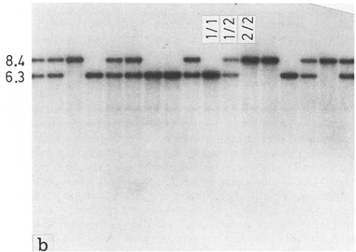
genetic map based on RFLP marker
50 F2 segregation individuals
the first rice molecular map
135 loci
cover 1389 cM of the rice genome
1/1=indica homozygote,2/2=javanica homozygote,1/2=heterozygote
McCouch, S. R., G. Kochert, et al, TAG,1998

Slide 24
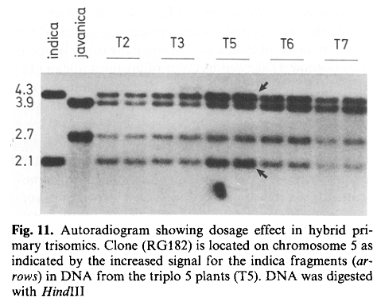
genetic map based on RFLP marker
assignment of linkage groups to chromosomes: dosage analysis
非整倍体
McCouch, S. R., G. Kochert, et al, TAG,1998

Slide 25
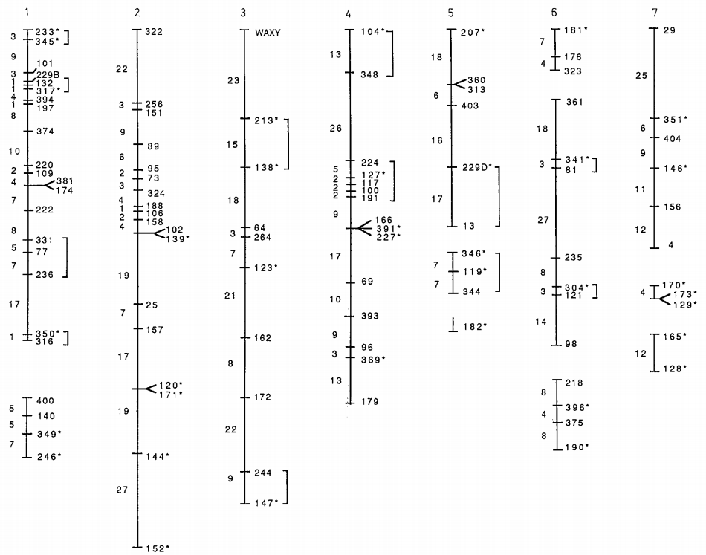
genetic map based on RFLP marker
McCouch, S. R., G. Kochert, et al, TAG,1998

Slide 26
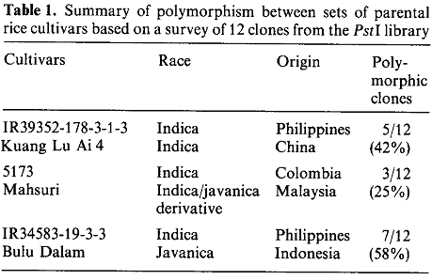
genetic map based on RFLP marker
亲本选择
分离群体
F2群体
作图工具
MAPMAKER
McCouch, S. R., G. Kochert, et al, TAG,1998

Slide 27
genetic map based on EST marker
186 F2
2275 markers
883 cDNAs + 265 genomic DNAs + 147 RAPD + 88 other + 934 cDNAs - 42
covers 1521.6 cM of the rice genome
the most detailed and informative genetic map of any plant
determine centromere location by dosage analysis
Harushima, Y., M. Yano, et al, Genetics, 1998

Slide 28
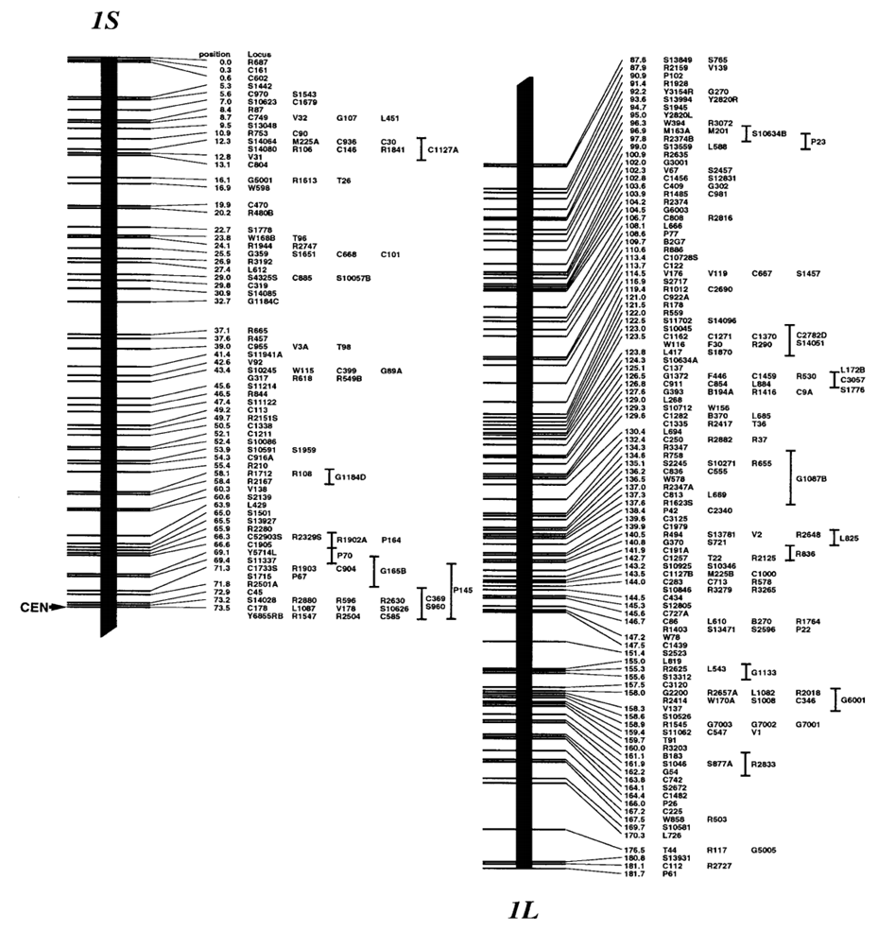
genetic map based on EST marker
Harushima, Y., M. Yano, et al, Genetics, 1998

Slide 29
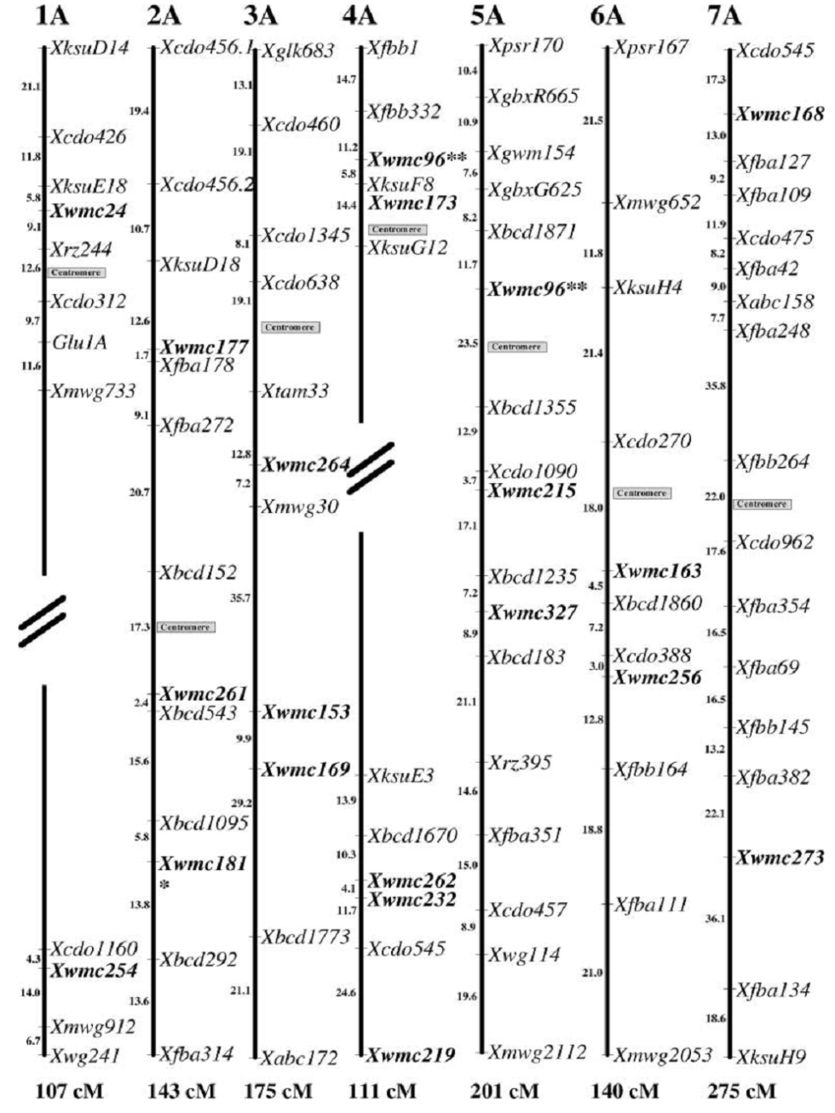
genetic map based on SSR marker
Gupta, P. G., H. B. Balyan, et al, TAG, 2002

Slide 30
genetic map based on SFP marker
SFP: Differences in hybridization intensity indicated differences in DNA sequence. The sequence differences, termed single feature polymorphisms
mismatched
perfectly matched
less affinity
more affinity
weaker signal
stronger signal
polymorphysim
Singer, T., Y. Fan, et al, PLoS Genetics , 2005

Slide 31
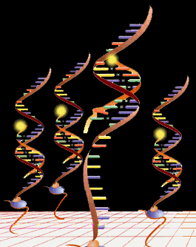
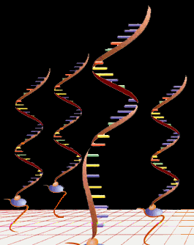
genetic map based on SFP marker
reference genome
Col
×
Ler
F1
×
…
×
RIL
探针的序列是已知的！

Slide 32
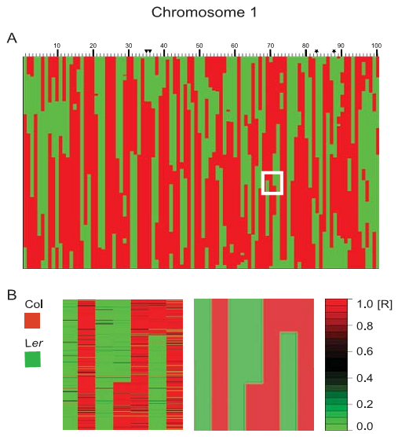
genetic map based on SFP marker
red: Col
green: Ler
black: lost
red lines in green region: genotyping error
green lines in red region: genotyping error
Singer, T., Y. Fan, et al, PLoS Genetics , 2005

Slide 33
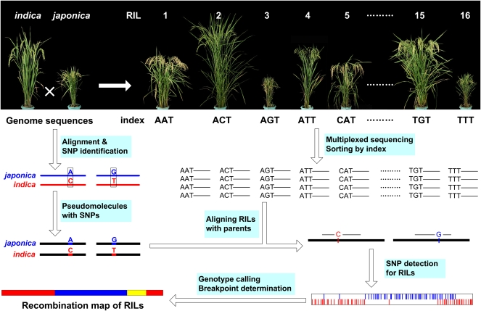
genetic map based on SNP marker
indica
9311
japonica
Nipponbare
×
F1
×
…
×
RIL
150×0.02 coverage
SNP的位置是知道的！
Huang, X., Q. Feng, et al, Genome Research, 2009

Slide 34
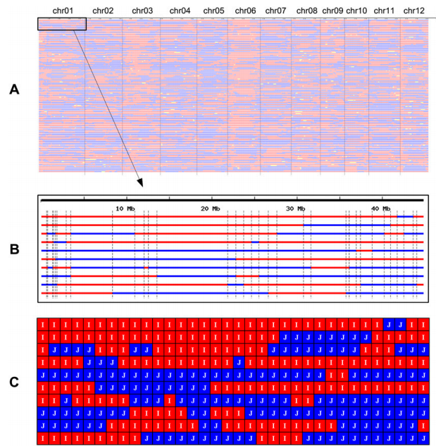
genetic map based on SNP marker
Recombination and bin maps. (A) Aligned recombination maps of 150 rice RILs. Red, ind/ind; blue, jap/jap; yellow, ind/jap. (B) Aligned chromosome 1 of the first ten RILs. Scale indicates physical distance. A vertical line labels a recombination breakpoint. A region between two vertical lines across all RILs is recognized as a recombination bin. (C) Bin map of the 10 RILs.
Huang, X., Q. Feng, et al, Genome Research, 2009

Slide 35
genetic map based on SNP marker
ZS97
×
MH63
whose genome sequence?
SY63
high coverage resequencing
of parents!
and
low coverage sequencing of RILs!
ZS97(13X)
×
MH63(13X)
…
100×0.02X
×
RIL
only low coverage sequencing of RILs!
100×0.02X

Slide 36
genetic map based on SNP marker
Identifying potential SNPs without sequences of the parents
Ref CCGAGCTAT..GCTGCCTTGC
R001 CCGAGCTAT..GCTGC
R015 CCGAGCCAT..GCTGCCT
R036 ...........GCTGCCTT
R057 CCGAGCCAT..GCTGCCTTG
R062 CCGAGCTAT..GCTGCCTTGC
R066 CGAGCCAT............
R083 GAGCCAT..GCTACCTTGC
R095 AGCTAT..GCTACCTTGC
R116 ......GCTACCTTGC
R135 AT............
R153 ..GCTACCTTGC
R206 TACCTTGC
A total of 15,795 potential SNPs obtained from RILs in Chr05, 1.9 kb/SNP
With sequence coverage ~0.055× for each RIL
~95% of SNP data is missing, ~1 SNP per 32kb was sequenced
Need to deal with low-quality SNPs
High-quality SNP
Low-quality SNP
Xie, W., Q. Feng, et al, Proc. Natl. Acad. Sci. USA, 2010

Slide 37
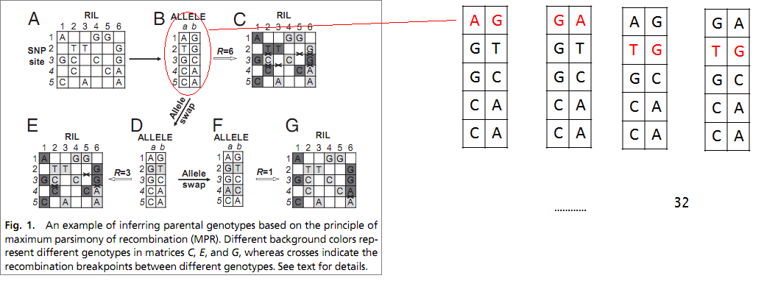
genetic map based on SNP marker
Xie, W., Q. Feng, et al, Proc. Natl. Acad. Sci. USA, 2010

Slide 38
phenotype data
遗传图谱
基因定位
基因座位和标记之间的连锁关系！

Slide 39
基因定位
分离群体分组混合分析
极端表型植株混合测序
高精度基因型重组图谱

Slide 40
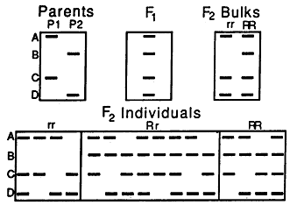
分离群体分组混合分析
RFLP and RAPD markers
B is linked in cis to the R allele;
A,C,D are unlinked to the R allele
R. W. MICHELMORE, P., AND R. V. KESSELI, Proc. Natl. Acad. Sci. USA, 1991

Slide 41
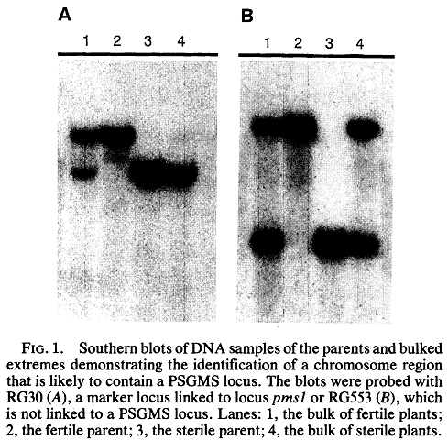
分离群体分组混合分析
step1: use bulked DNA from extreme plants to identify the chromosomal segments likely to carry sterility vs. fertility alleles
可育对不育是显性的
只需要四个个体：两个亲本和两个 极端表型植株
Zhang, Q., B. Z. Shen, et al, Proc. Natl. Acad. Sci. USA, 1994

Slide 42
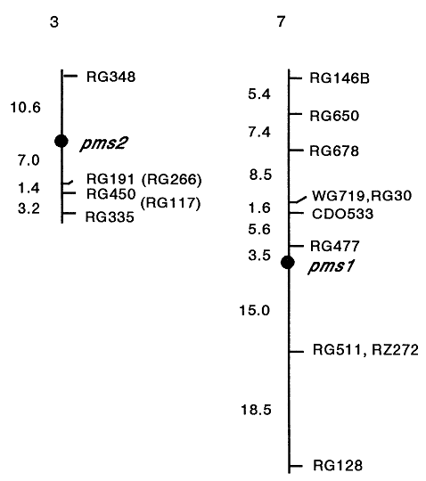
分离群体分组混合分析
step2: determine the chromosomal locations of PSGMS loci for the extremely sterile individuals
c = (N₁ + N₂/2)/N
N: the total number of the sterile plants surveyed
N₁: the number of individuals homozygous for the
RFLP band from the fertile parent
N₂: the number of individuals heterozygous for bands
from the two parents
Zhang, Q., B. Z. Shen, et al, Proc. Natl. Acad. Sci. USA, 1994

Slide 43
极端表型植株混合测序
SHOREmap: simultaneous mapping and mutation identification by deep sequencing
F₂ population
Bulk segregant analysis (BSA)
Deep sequencing
Software package SHOREmap (http://www.1001genomes.org/software/shoremap.html)
Schneeberger, Ossowski, et al., Nat Methods, 2009

Slide 44
极端表型植株混合测序
X
Col
Ler
F1
F2
Schneeberger, Ossowski, et al., Nat Methods, 2009

Slide 45
极端表型植株混合测序
Schneeberger, Ossowski, et al., Nat Methods, 2009

Slide 46
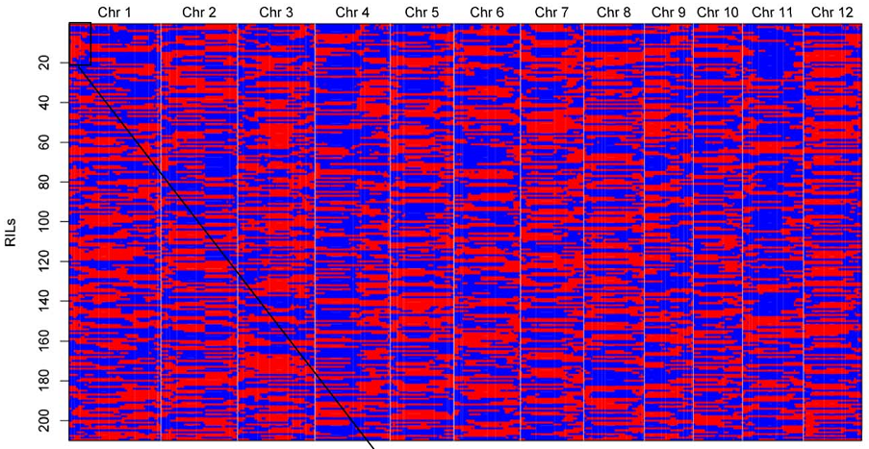
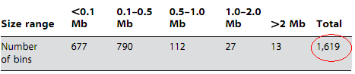
高精度基因型重组图谱
ZS97
×
MH63
SY63
×
…
×
241RILs
redundant, heterozygous
210RILs
Yu, H., W. Xie, et al, PLoS ONE, 2011

Slide 47
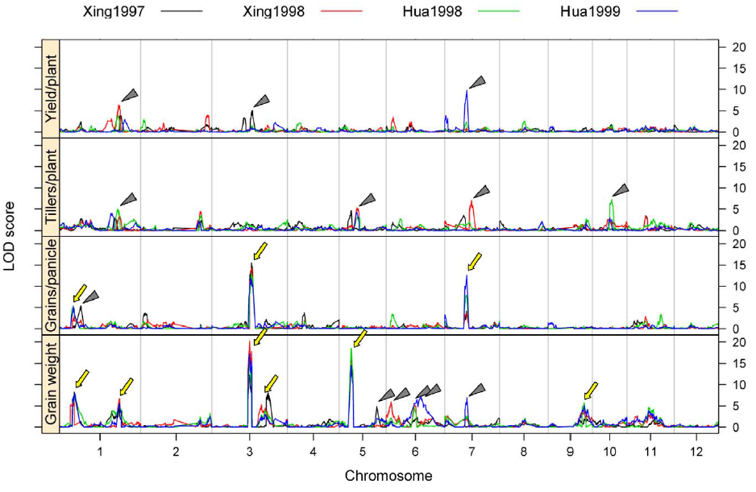
QTL scanning

Slide 48
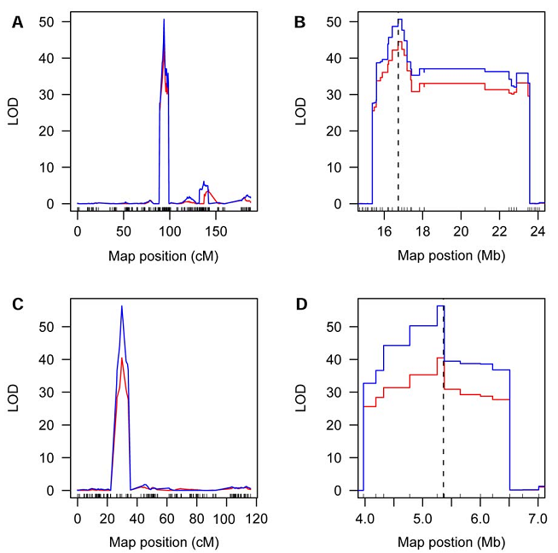
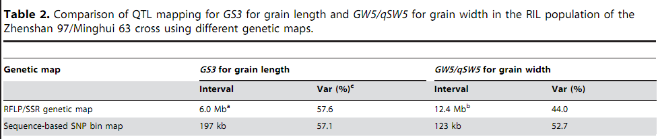
高精度基因型重组图谱
Yu, H., W. Xie, et al, PLoS ONE, 2011

Slide 49
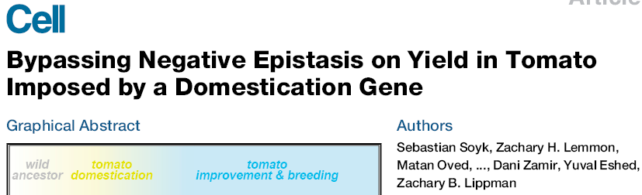
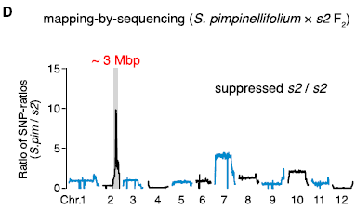
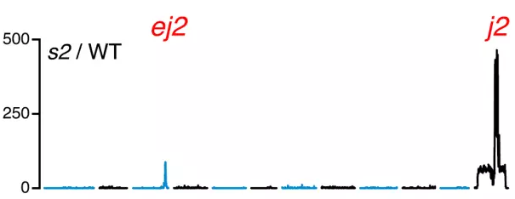

Slide 50
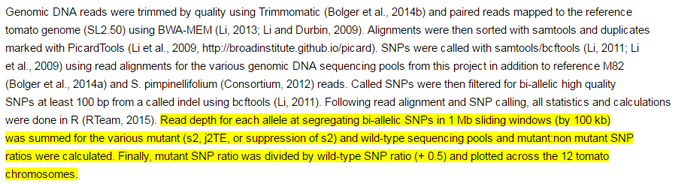
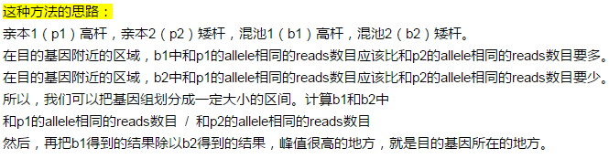

Slide 51
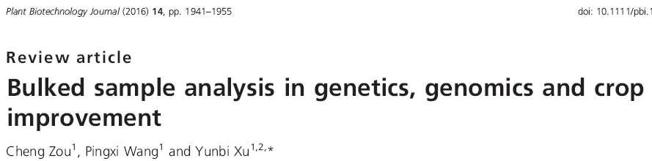
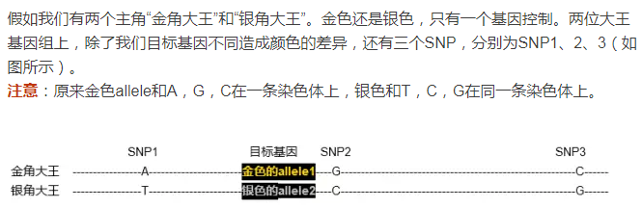
https://mp.weixin.qq.com/s?__biz=MzI1MjU5MjMzNA%3D%3D&mid=2247484268&idx=1&sn=18c9b720fbe5fec1522960de33b831fd&scene=45#wechat_redirect

Slide 52
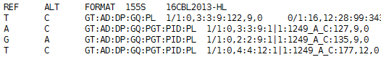
SNP数据处理
##FORMAT=<ID=AD,Number=R,Type=Integer,Description="Allelic depths for the ref and alt alleles in the order listed">
Raw data：5404296
QUAL ≥ 200
4863252
16CP27和9311纯合
4230727
16CP27和9311有多态性
769100
p1 ≥ 3 & p2 ≥ 3 & b1 ≥ 4 & b2 ≥ 4
p1 ≤ 60 & p2 ≤ 60 & b1 ≤ 60 & b2 ≤ 60
369558

Slide 53
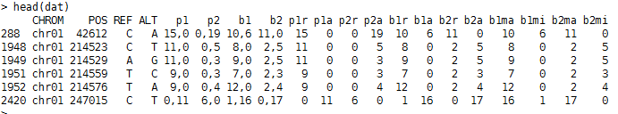
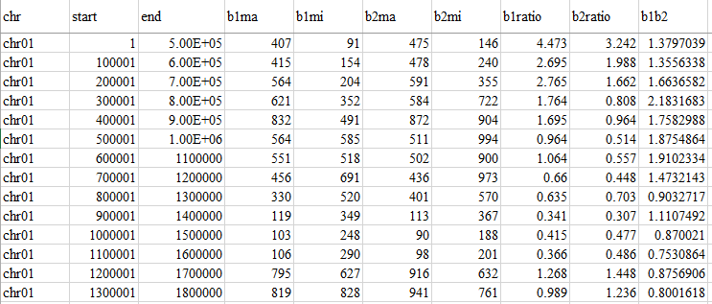
Window: 500kb
Step: 100kb

Slide 54
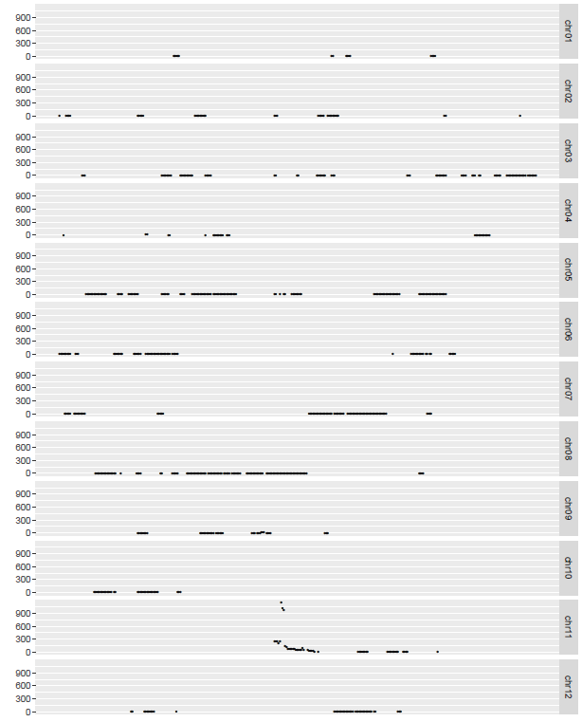

Slide 55
T测验用于RIL群体QTL分析

Slide 56
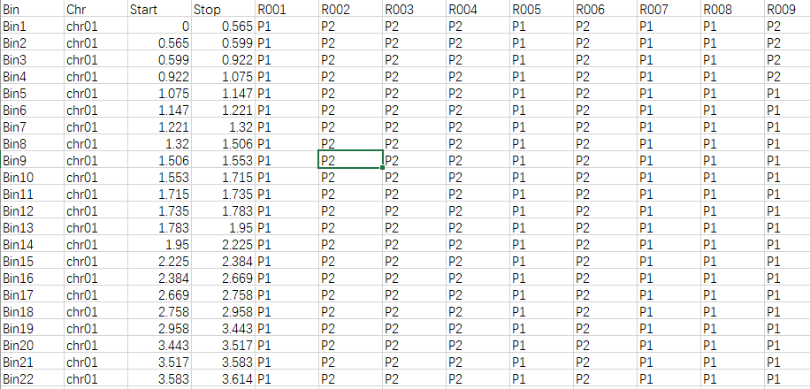
Genetic map of 210 RILs

Slide 57
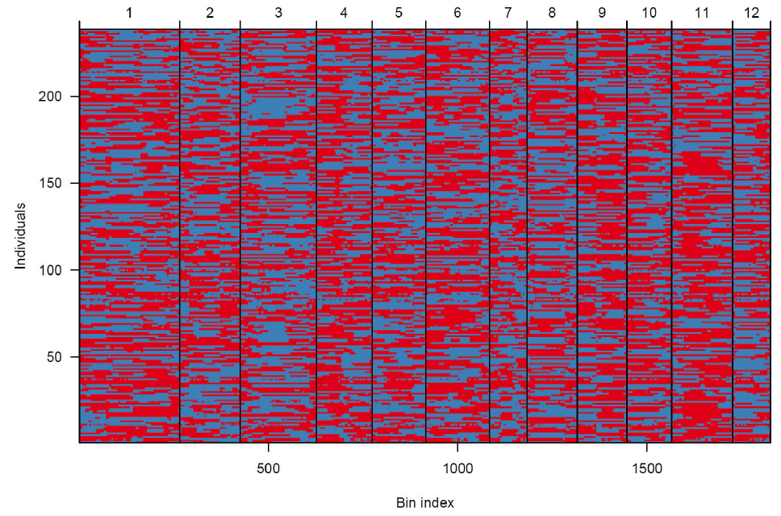
Genetic map of 210 RILs

Slide 58
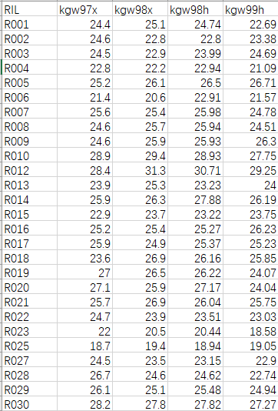
Phenotype of 210 RILs

Slide 59
setwd("E:/jianguoyun/binQTL/real-data/RIL")
geno <- read.csv("geno.4cim.csv", head=T, as.is=T)
phe <- read.csv("pheRIL.csv", head=T, as.is=T)
p.val <- sapply(1:nrow(geno), function(i){
i.geno <- unlist(geno[i, -c(1:3)])
i.geno.0 <- i.geno[i.geno == 0]
i.geno.1 <- i.geno[i.geno == 1]
i.phe.0 <- phe$kgw97x[phe$RIL %in% names(i.geno.0)]
i.phe.1 <- phe$kgw97x[phe$RIL %in% names(i.geno.1)]
i.test <- t.test(i.phe.0, i.phe.1)
i.test.p <- i.test$p.value
return(i.test.p)
})
i <- 1
i.geno <- unlist(geno[i, -c(1:3)])
i.geno.0 <- i.geno[i.geno == 0]
i.geno.1 <- i.geno[i.geno == 1]
i.phe.0 <- phe$kgw97x[phe$RIL %in% names(i.geno.0)]
i.phe.1 <- phe$kgw97x[phe$RIL %in% names(i.geno.1)]
i.test <- t.test(i.phe.0, i.phe.1)
i.test.p <- i.test$p.value
i <- 439
i.geno <- unlist(geno[i, -c(1:3)])
i.geno.0 <- i.geno[i.geno == 0]
i.geno.1 <- i.geno[i.geno == 1]
i.phe.0 <- phe$kgw97x[phe$RIL %in% names(i.geno.0)]
i.phe.1 <- phe$kgw97x[phe$RIL %in% names(i.geno.1)]
i.test <- t.test(i.phe.0, i.phe.1)
i.test.p <- i.test$p.value
plot(-log10(p.val), pch=19)

Slide 60


i=1

Slide 61


i=1

Slide 62


i=439

Slide 63


i=439

Slide 64

QTL scanning result

Slide 65
方差分析用于F₂群体QTL分析

Slide 66

Genetic map of 278 F₂s

Slide 67

Genetic map of 278 F₂s

Slide 68

Phenotype of 278 F₂s

Slide 69
setwd("E:/jianguoyun/binQTL/real-data/IMF2")
geno <- read.csv("geno.4cim.csv", head=T, as.is=T)
phe <- read.csv("pheF2.csv", head=T, as.is=T)
p.val <- sapply(1:nrow(geno), function(i){
i.geno <- unlist(geno[i, -c(1:3)])
i.phe <- cbind(phe, i.geno)
i.test <- aov(kgw98~i.geno, data=i.phe)
i.test.p <- summary(i.test)[[1]][1, 5]
return(i.test.p)
})
i <- 1
i.geno <- unlist(geno[i, -c(1:3)])
i.phe <- cbind(phe, i.geno)
i.test <- aov(kgw98~i.geno, data=i.phe)
i.test.p <- summary(i.test)[[1]][1, 5]
boxplot(kgw98~i.geno, data=i.phe)
i <- 439
i.geno <- unlist(geno[i, -c(1:3)])
i.phe <- cbind(phe, i.geno)
i.test <- aov(kgw98~i.geno, data=i.phe)
i.test.p <- summary(i.test)[[1]][1, 5]
boxplot(kgw98~i.geno, data=i.phe)
plot(-log10(p.val), pch=19)

Slide 70


i=1

Slide 71


i=439

Slide 72


Slide 73

QTL scanning result

